Slide 1
The Tall Thin Molecular Programmer
Erik Winfree
Computer Science, Computation and Neural Systems, Bioengineering
California Institute of Technology
Notes:
My aim in this talk is to introduce you to a subfield of biomolecular engineering and point out some conceptual similarities to computer engineering. Alas, I won’t be focusing on specific applications, nor will I get into details of system design and performance metrics. Also, in places I will be somewhat speculative, so what I say should be taken with a grain of salt. What I hope to accomplish is to give you a new perspective on chemistry that perhaps makes it less alien to your way of thinking — if, that is, you currently think of chemistry as sloppy smelly messy stuff that works for mysterious reasons and requires trial and error to develop. Some parts of chemistry might fit that mold, but the interesting thing today is a growing subfield that appears to share many essential features of computer engineering.

Slide 2
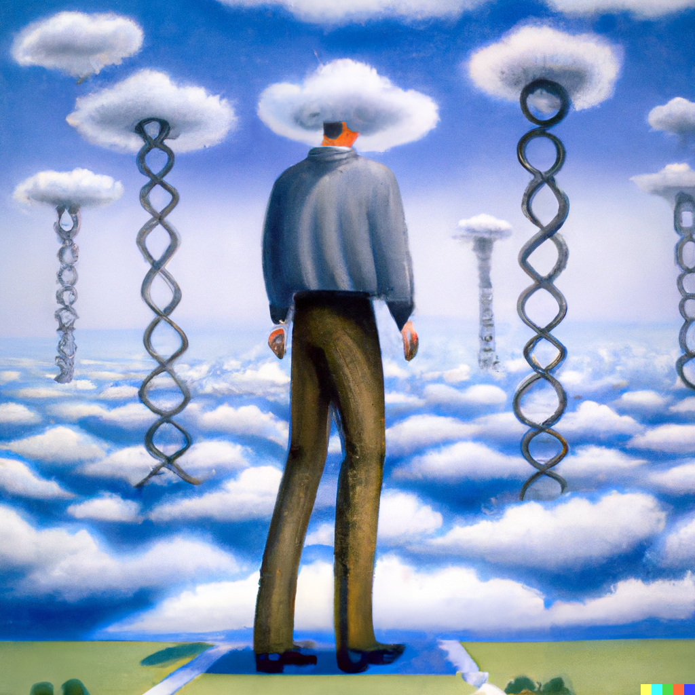
Outline
The tall thin molecular programmer
Information revolutions
DNA nanotechnology
Past present future
Mastering complexity
…with their head in the clouds and their feet on the ground.
Notes:
The title of my talk is meant to remind you of a phrase Carver Mead used back in the 1980’s near the start of the VLSI revolution — he talked about a “tall thin computer engineer” who could understand the full stack from high-level languages all the way down to device physics, and how such people could do wonderful things that teams of specialists could not. My field, DNA nanotechnology, is at such a stage where the analogous person — the tall thin molecular programmer — is also playing a similarly critical role. I’ll begin by motivating my corner of science and technology in broad strokes, speculate a bit about where it might be going, and highlight how concepts from computer science will be essential to its development.

Slide 3
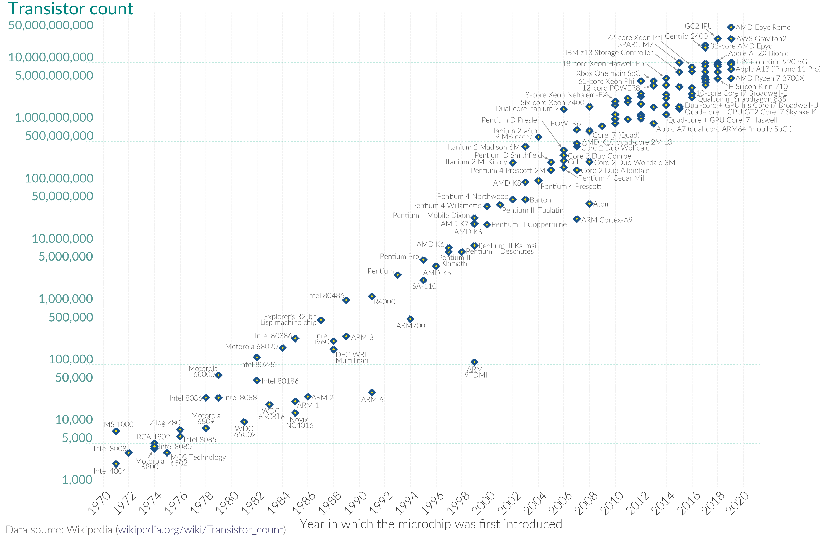
Moore’s Law for Microprocessors
Notes:
This slide is hardly necessary at a conference like ISSCC. The transistor count in microprocessors has been growing exponentially since 1970, roughly doubling every two to three years, and now exceeding 100 billion. This plot starts in 1971 with the Intel 4004 and its 2300 transistors, but one might want to go back to 1947 when the transistor was invented, and let’s call that a count of 1. Same doubling rate, roughly.
What features of the technology permitted this kind of explosive growth, and what other technologies can be expected to grow similarly? I’m not an expert on this question, and I’m sure there’s a lot to say by those who know more, but for the purposes of comparing to biomolecular engineering, I’d like to focus on the fact that computers are an information technology. It’s all the same stuff — transistors — just organized in special ways such that the bits work together and get the job done. A major bottleneck is the sheer complexity — there’s so much information in the design of a 100 billion transistor chip, and more information when you start running it. And the computer industry found ways to master that complexity.

Slide 4
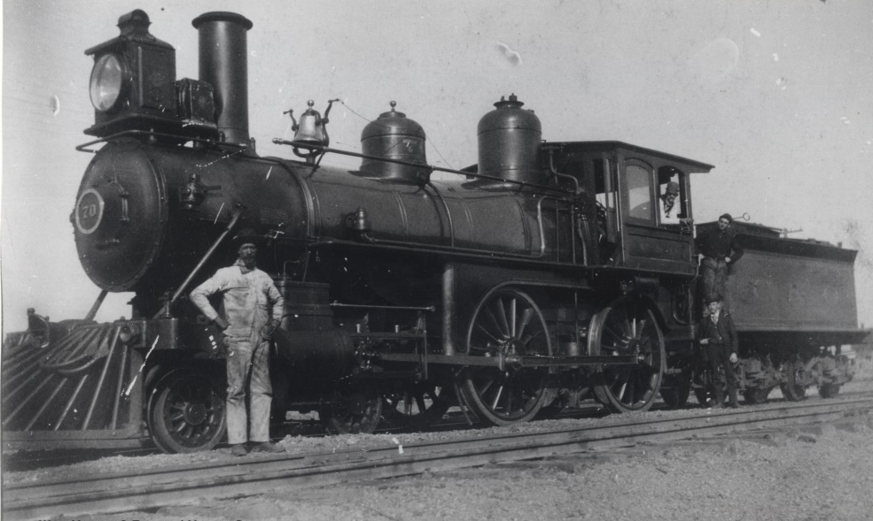
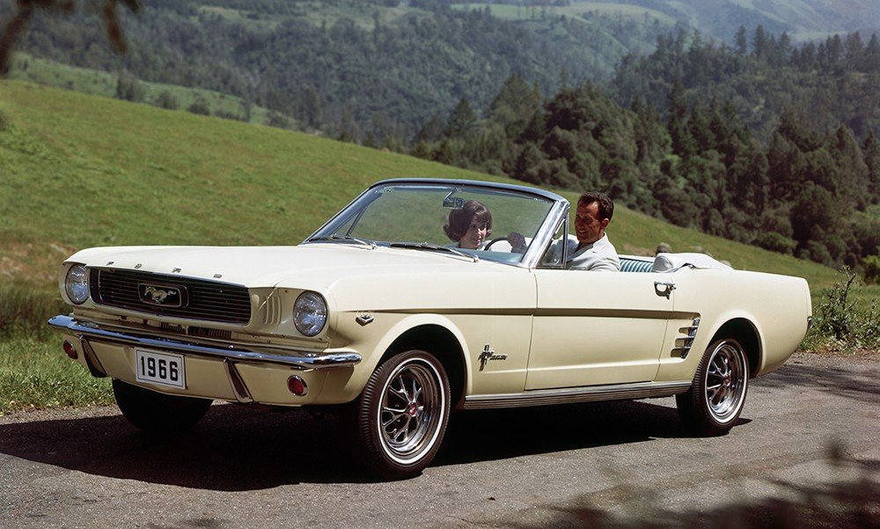



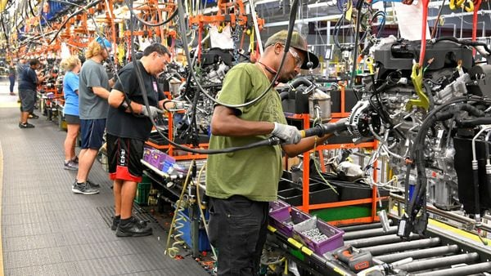
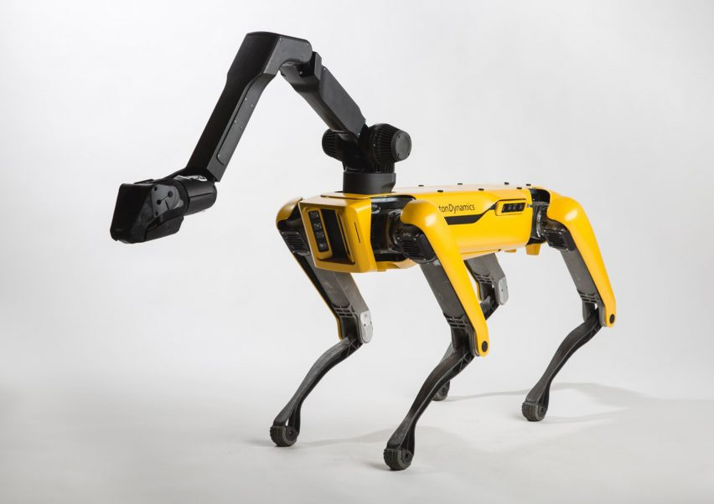
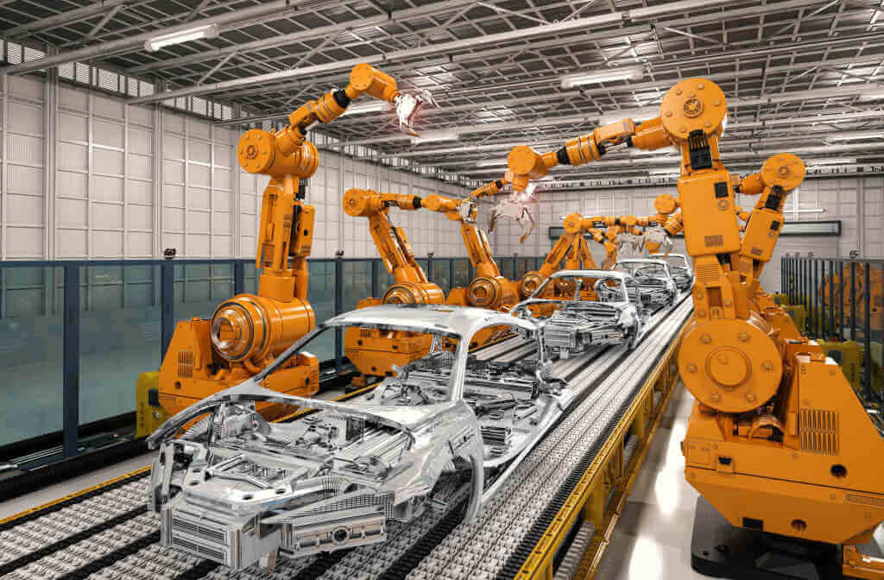
The Modern Information Revolution
from this
to this
human information processing
autonomous information processing
Notes:
Where did that get us? The industrial revolution gave us engines and motors and mechanical devices that transformed civilization by giving humans a seeming unbounded amount of power. But that power was directed by the human operator who controlled the machinery. In roughly the past 75 years, the advent of electronic computers has transformed the world again, and now autonomous information processing not only performs computation and communication tasks, but also controls an increasing array of real-world mechanical systems. We can program the behavior of electromechanical machines thanks to embedded controllers.

Slide 5


The Ancient Information Revolution
from this
to this
Don Dixon
Thomas Mangelsen
blind physical / chemical processes
chemical information processing
4.5 billion years ago
0 billion years ago
Earth forms
~4.0 BYA
life
~3.5 BYA
LUCA
~2.5 BYA
oxygen
~2.0 BYA
plants
~0.5 BYA
fish
~0.2 BYA
mammals
~0.01 BYA
hominids
Notes:
This wasn’t the first time that information storage and information processing transformed the world. Nobody knows how life got started, but we do know that the key new ingredients were the ability of chemical systems to store information, for example in a genome, for that information to be used to direct molecular systems and circuits that direct the growth and behavior of organisms, and for that information to be passed down with rare mutations during replication so that Darwinian evolution can explore the design space and optimize. It took 4 billion years, but these processes created the incredible diversity of life on earth.

Slide 6
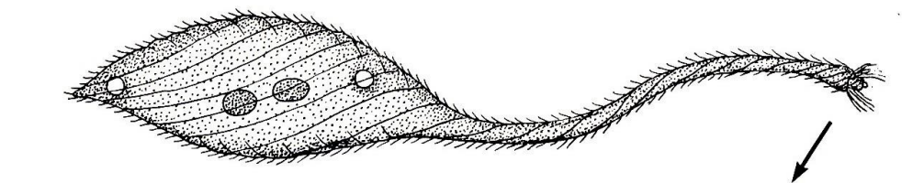
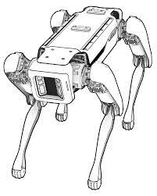
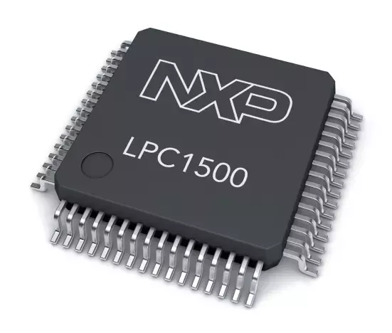
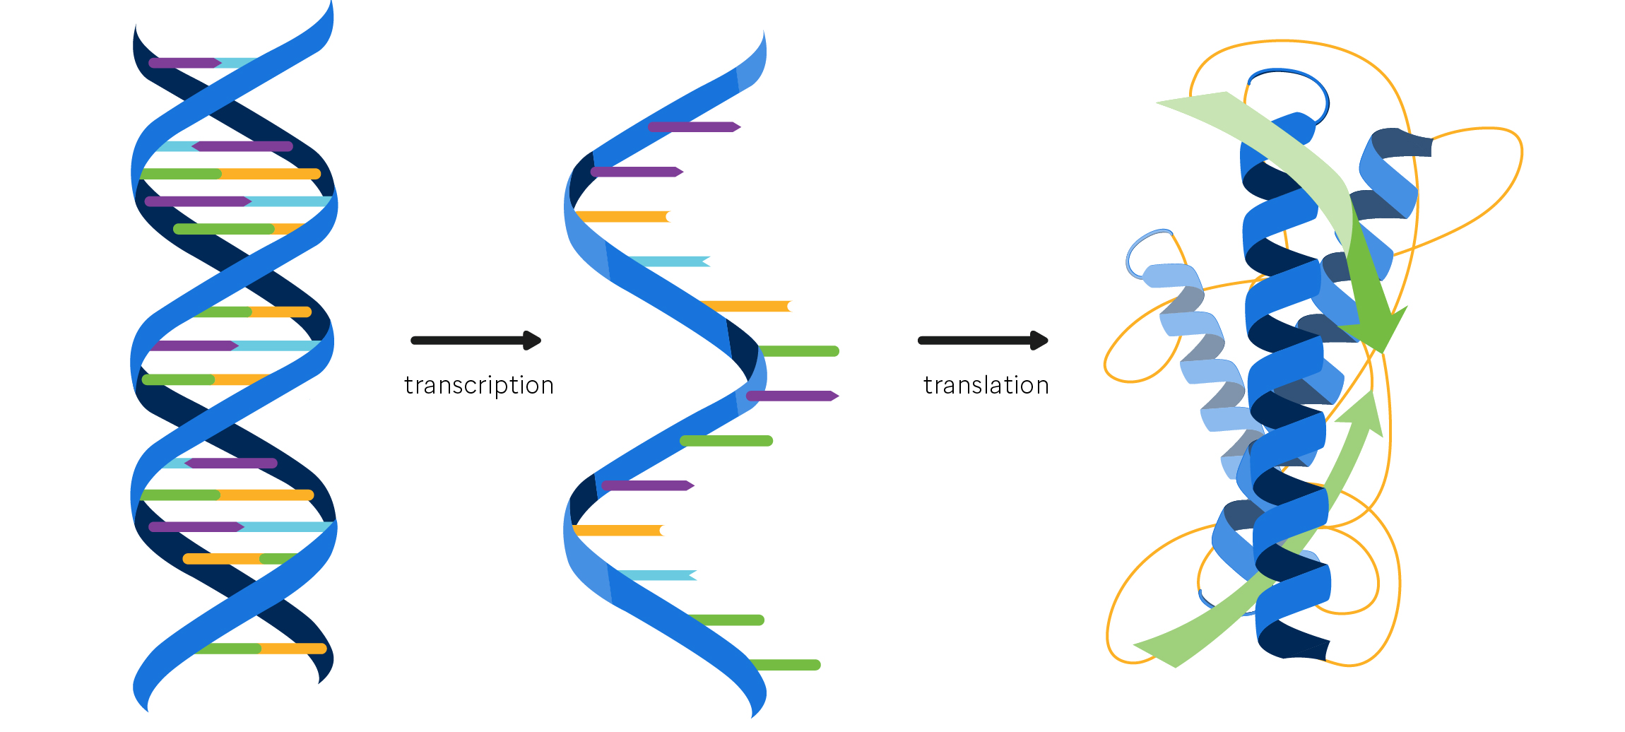
Embedded Information Processing
electromechanical robots
biological cells
control: microprocessors
control: central dogma of molecular biology
Notes:
The essential similarity of both these information revolutions is just how much capability can be unleashed by embedded information processing within machines — whether electromechanical or molecular — that autonomously interact with their environments. We have microprocessors within robots, and we have DNA, RNA, and protein circuits within biological cells. One was engineered, the other evolved, but from a certain perspective, that’s not a fundamental difference.

Slide 7
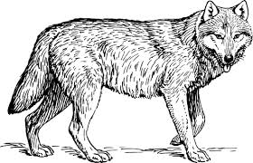
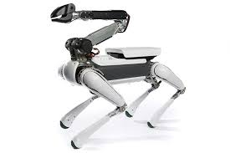
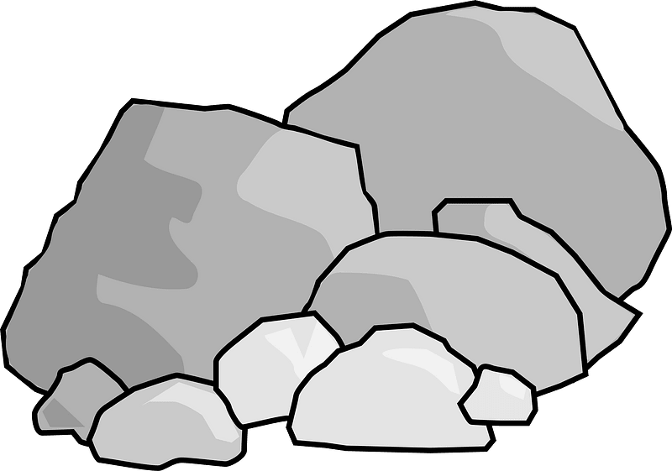
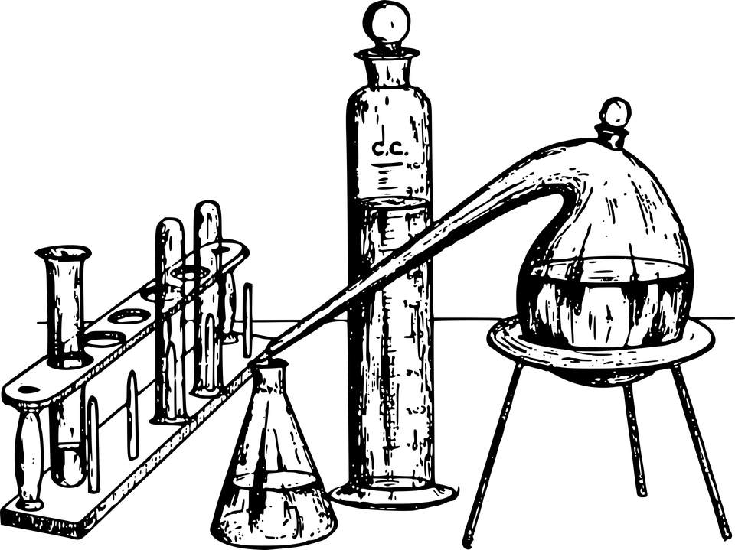
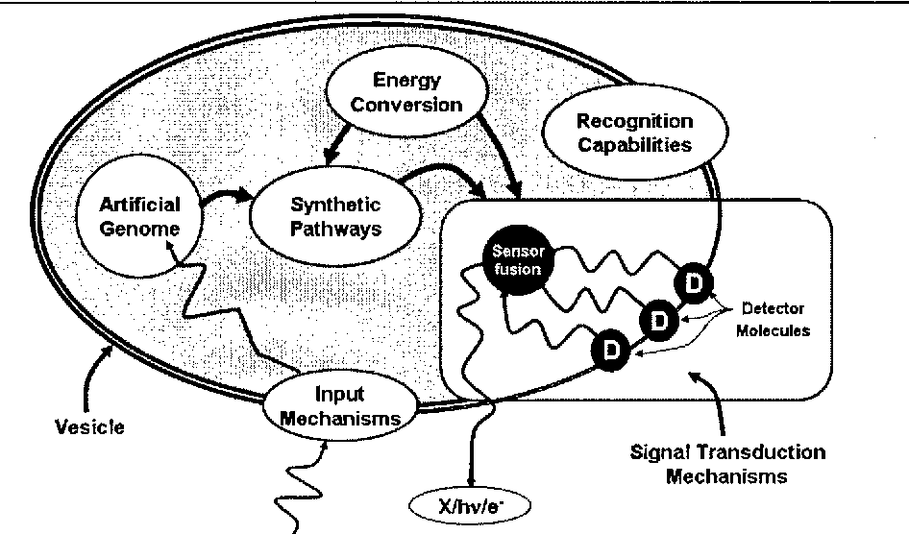
The Challenge of Molecular Programming
inspiration
from this
to this
:
→
?
:
→
Notes:
What are the implications for today’s technology? It is a common cycle in technology to be first inspired by the capabilities of biological organisms, and then to eventually learn how to transform raw, dead materials into machines that replicate some of those capabilities. While turning silicon and oil into an artificial dog is now within our repertoire, making an artificial cell from raw chemicals is not. But it is within the realm of possibility, and as a challenge it can guide our thinking about how to approach the engineering of complex molecular systems. Along the way to this distant goal, many technological discoveries will have more immediate applications.

Slide 8
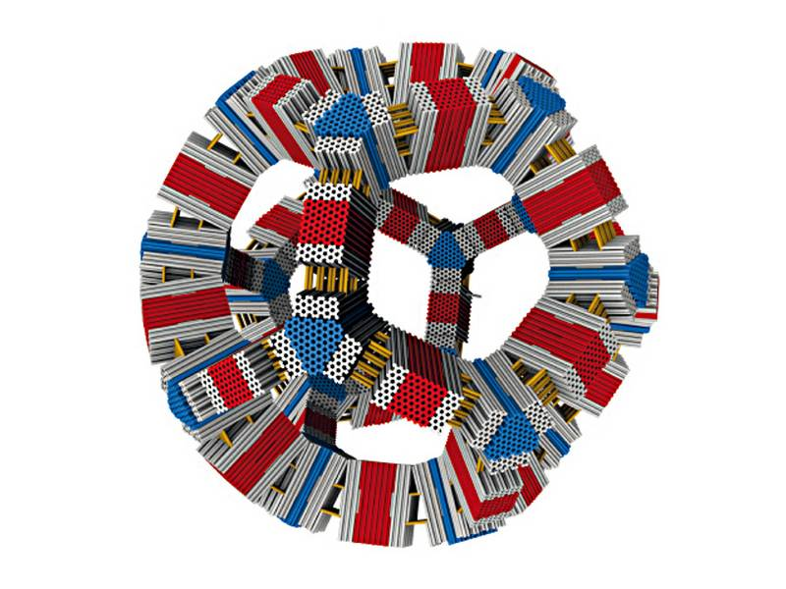
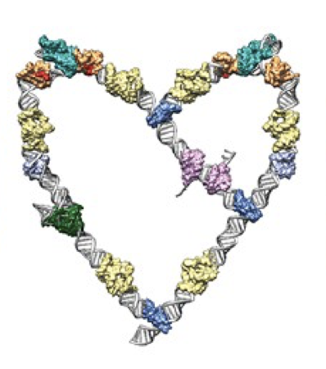
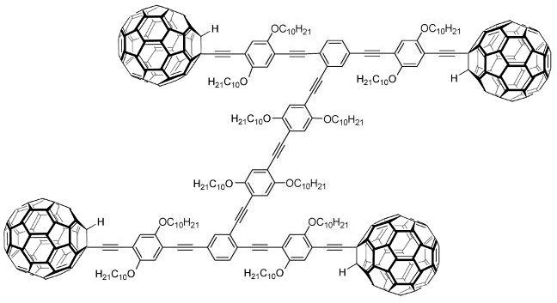
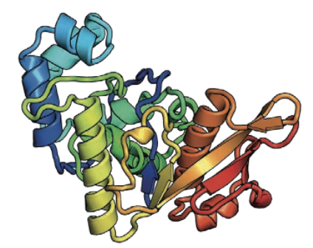
De Novo Molecular Systems Engineering
synthetic chemistry
protein design
RNA design
DNA design
Shirai, … , Tour
Nano Letters, 2005
Huang, Boyken, Baker,
Nature, 2016
Geary, …, Jaeger,
Nano Letters, 2017
Wagenbauer, Sigl, Dietz,
Nature, 2017
Nucleic acids are especially suitable for exploring
the fundamental principles of
information-based molecular systems
and molecular programming
structural DNA nanotechnology and dynamic DNA nanotechnology
Notes:
A first question is what kind of molecules should we use? Synthetic chemistry can make complex covalently bonded structures with precision at the atomic scale, such as this 8 nanometer go-cart with rolling wheels. But it’s hard, and it’s slow, and it’s fraught with surprises. Others have turned to biology and learned how to build things from scratch by using evolutionarily successful building blocks, such as the 20 amino acids in proteins. Despite the incredible versatility of these building blocks and the amazing diversity of function exhibited in biology, their complexity remains daunting for engineering. Today I will be telling you about engineering with nucleic acids, RNA and especially DNA. They are far simpler chemically, with just four building blocks A, T, C, and G, yet by putting those building blocks together in different sequences, a remarkable range of molecular systems can be designed. Indeed, they are the perfect place to start for learning how information within molecules can be used to program molecular structure and function. This is what DNA nanotechnology is all about.

Slide 9
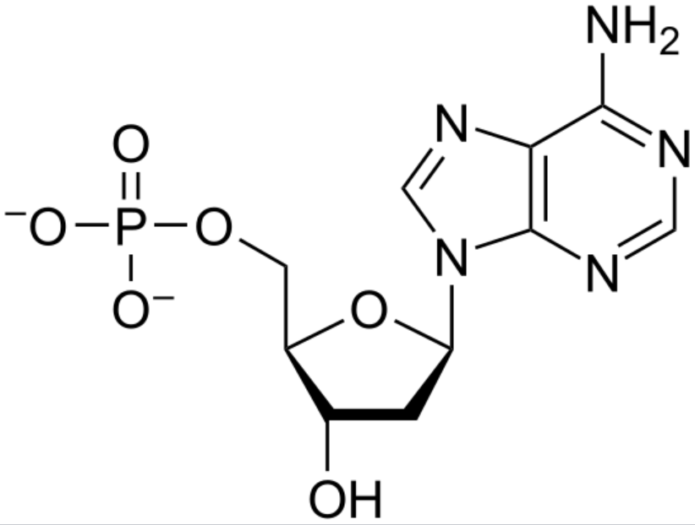
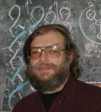
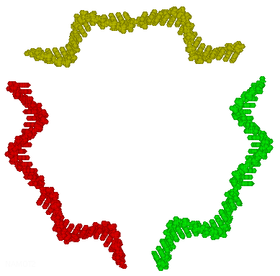
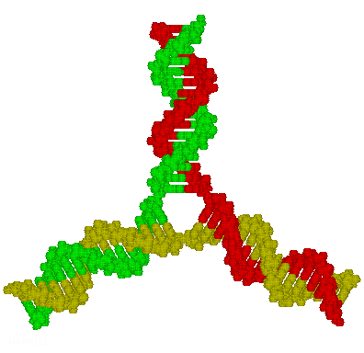
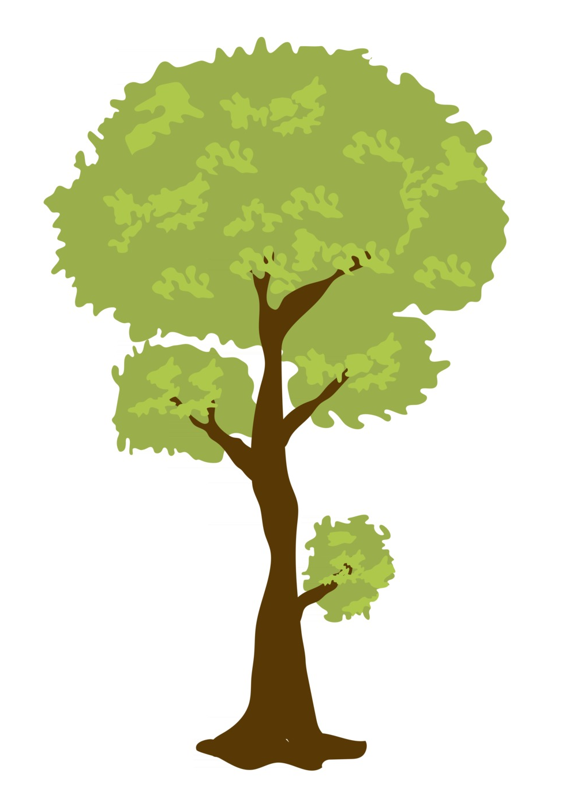
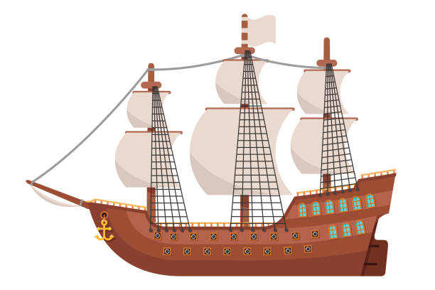
DNA as an Engineering Material
A =
TAGGCAG
CTAATGT
TGACCAC
ACTGGTG
→
TGACCAC
ACTGGTG
TAGGCAG
CTAATGT
Nadrian C. Seeman
1945-2021
GATTACA
ATCCGTC
ATCCGTC
GATTACA
Seeman, JTB, 1982; Kallenbach, Ma, Seeman, Nature, 1983
Watson-Crick base-pairing
can be used to program self-assembly
Notes:
DNA nanotechnology was the brainchild of a visionary chemist, Ned Seeman. He realized, in 1982, that the ability to synthesize single-stranded DNA molecules with arbitrary sequences confers the ability to program molecules to self-assemble based on Watson-Crick complementarity: A pairs with T, C pairs with G. Designing DNA molecules with sufficiently distinct DNA “barcodes” ensures specific binding interactions, allowing one to create self-assembling structures that have absolutely nothing to do with biology. As a metaphor, consider how shipbuilders learned how to take a biological material, wood, and refashion it for utterly non-biological purposes.

Slide 10
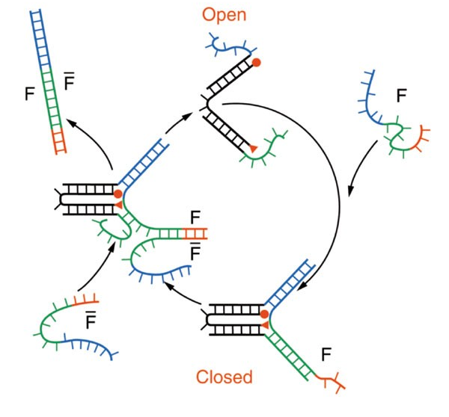
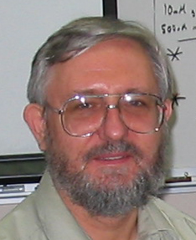

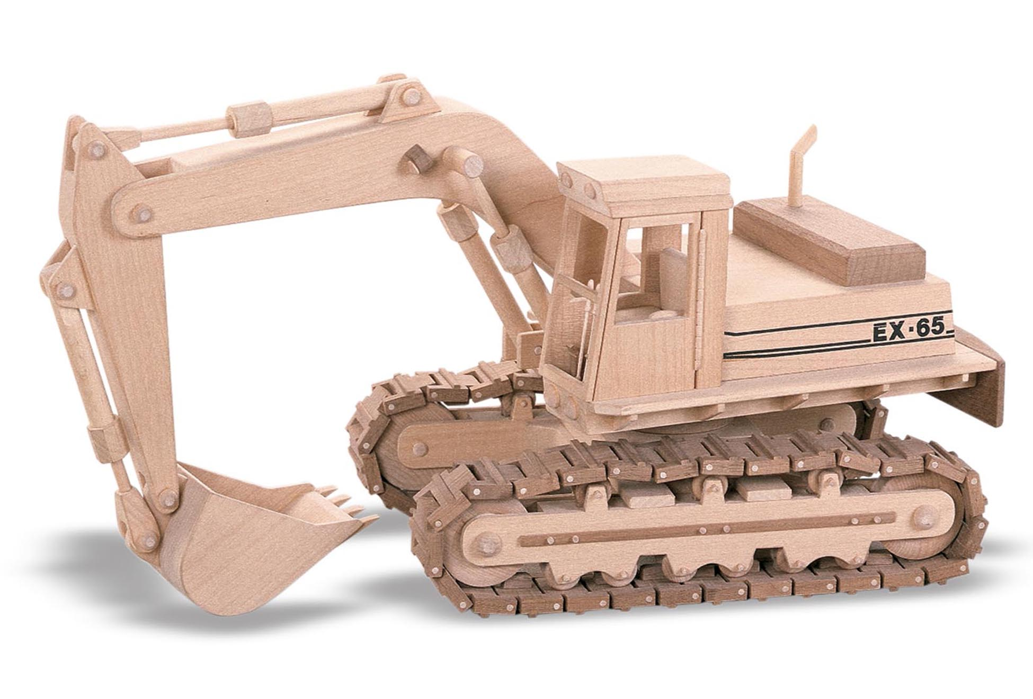
DNA as an Engineering Material: Mechanical
Bernard Yurke
Andrew Turberfield
Turberfield, Yurke, et al,
Nature, 2000
toehold-mediated strand displacement controls mechanical motion
Notes:
As an engineering material, not only can DNA be programmed to make structures, but it can be programmed to perform mechanical movements triggered by, you guessed it, commands encoded in DNA. Here we see so-called DNA tweezers that are naturally in an open state; when strand F arrives, because it has Watson-Crick complementary subsequences, it binds to two single-stranded tails of the tweezers, pulling the structure into a closed configuration. To later open the tweezers again, we use strand F-bar, which is perfectly complementary to F. When it arrives, it first binds to the red “toehold” sequence, and then through a random-walk process it displaces the previous contacts and removes F from the tweezers, allowing it to spontaneously open. In our metaphor, this is analogous to building mechanical devices out of wood that have moving parts.

Slide 11
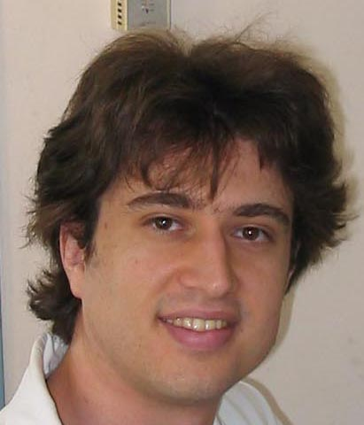
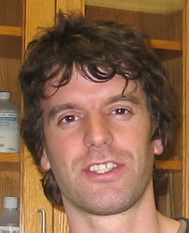
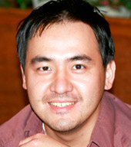
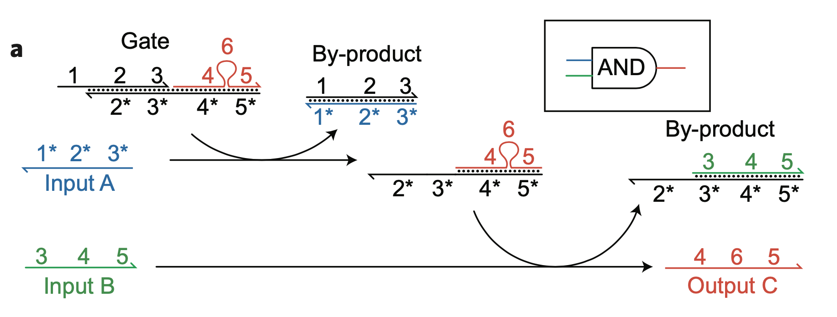
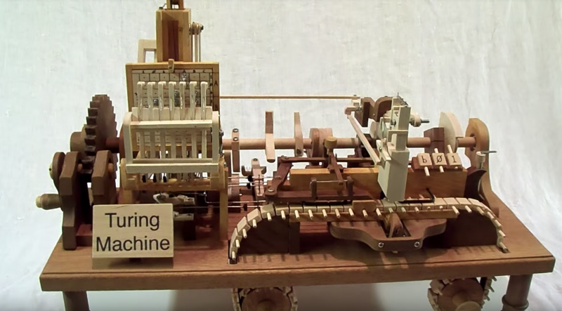
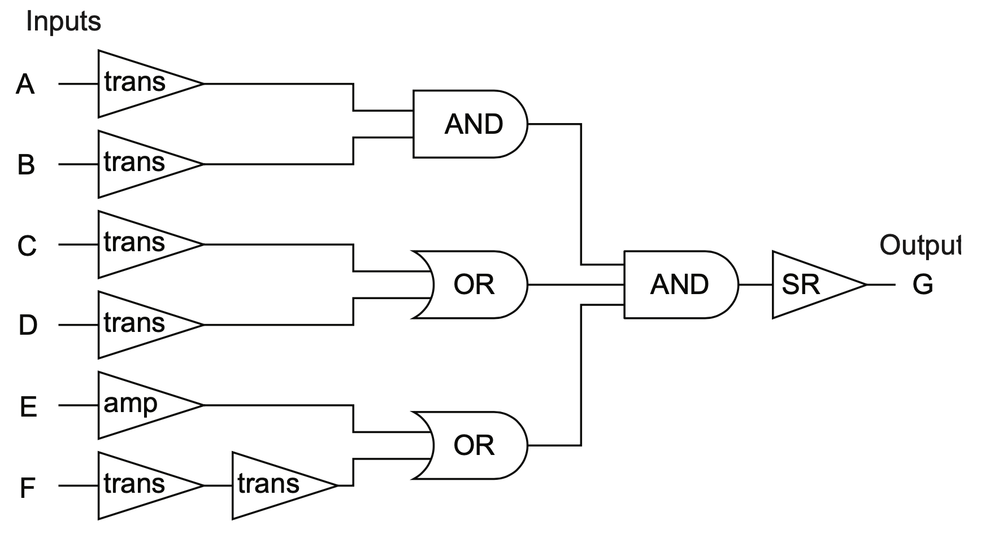
DNA as an Engineering Material: Computational
David Soloveichik
Georg Seelig
David Zhang
Richard Ridel’s wooden Turing machine, 2015
Seelig, Soloveichik, Zhang, Winfree, 2006
Zhang & Seelig, 2011
toehold-mediated strand displacement cascades for input/output logic
Notes:
The toehold-mediated DNA strand displacement principle can be used to build computing circuits. Here’s one way to make an AND gate. The first input strips off the first protecting strand. The second input now has a toehold to bind to, allowing it to kick off the output strand. This output strand has a new sequence exposed, so it can serve as the input to a downstream logic gate. In this way circuits can be composed. The metaphor might be to building a Turing machine out of cut-up trees, as shown here.
With the ability to program structure, mechanics, and computation, DNA nanotechnology has been very attractive to researchers interested in engineering molecular-scale robotic systems that reproduce some of the amazing functions of biological cells. How far have they gotten?

Slide 12
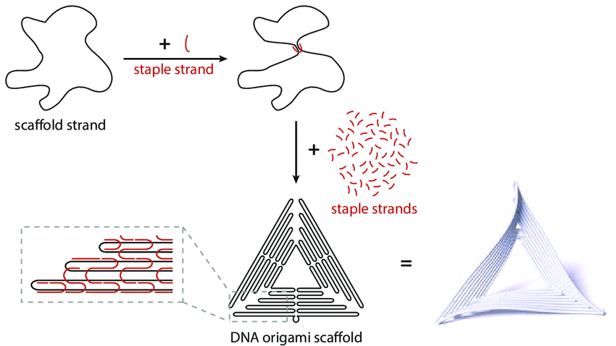
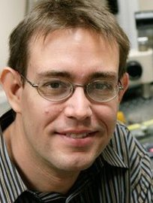
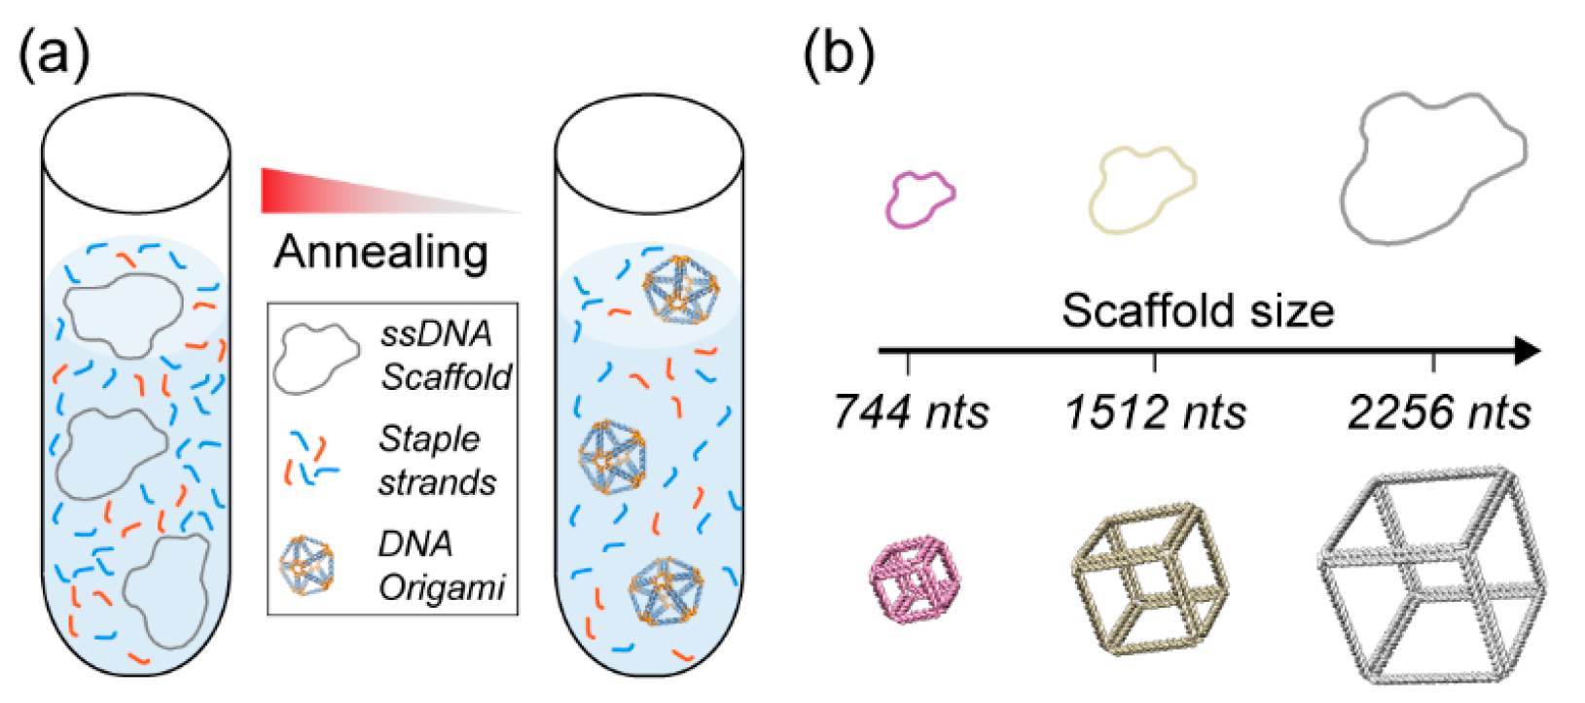
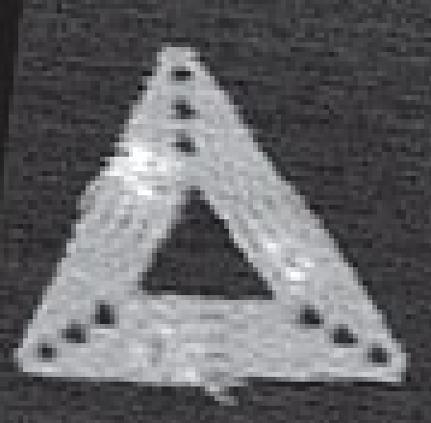
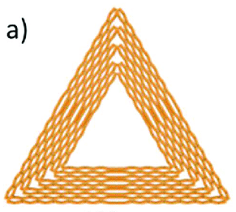
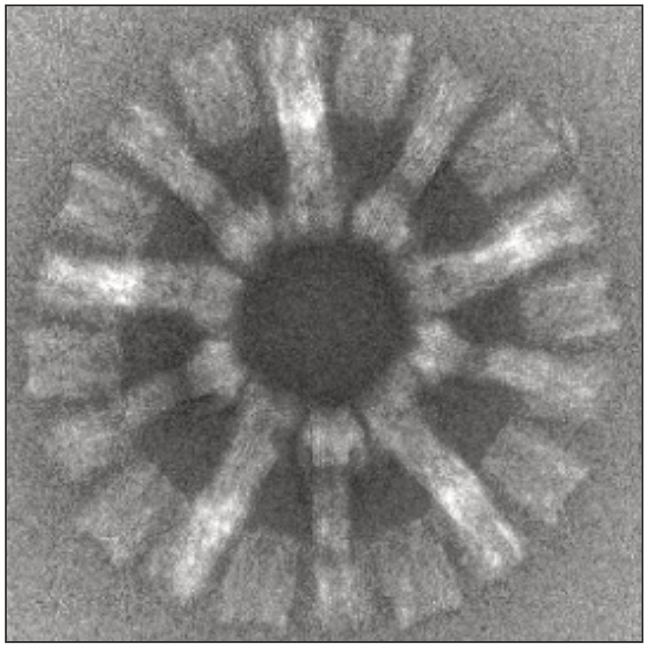
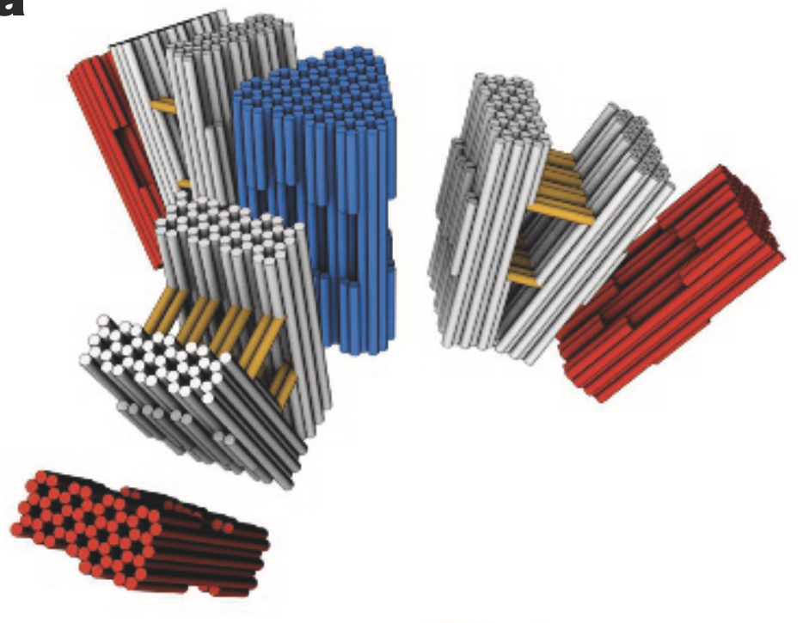
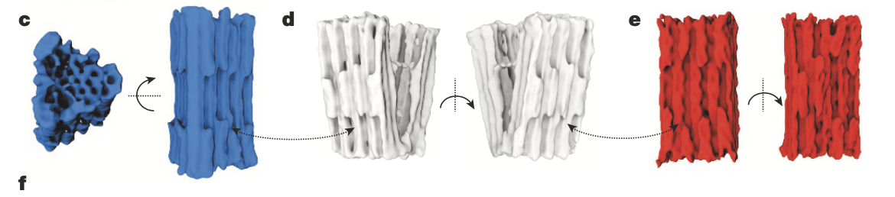
Self-Assembly of DNA origami structures
one-pot assembly
hot
cold
anneal
Paul Rothemund
AFM, 130 nm
Paul Rothemund, Nature, 2006
figs: Heck 2018; Bush 2020; Kielar 2020
multi-stage assembly
+
+
TEM, 430 nm
Wagenbauer, Sigl, Dietz, Nature, 2017
Notes:
The field of DNA nanotechnology experienced a phase change in 2006 with the arrival of a technique known as DNA origami. It was invented by the greatest singular genius I have known, Paul Rothemund, in the same building at Caltech where Ali and I both have our labs, so I had a very privileged view of this historical event. Here’s the miracle: Suppose you have in your refrigerator a test tube containing 100 billion copies of a circular single-stranded piece of DNA with known sequence — maybe 8000 nucleotides, no repeats or other regularities, so each position along its length can be identified with a specific subsequence. If you imagine how you want it to fold up, say into a triangle for example, then you know which parts should be next to each other. Design short DNA strands complementary to both subsequences wherever you want to staple the long strand together. With hundreds of such “staple strands”, you can control the self-assembly of DNA into almost arbitrary structures that are around 100 nm in size. Just by mixing the strands together in one pot, heating it up, and cooling it down.
DNA origami works in 3D too. Very large structures can be synthesized by first using the DNA origami technique to create well-defined 3D subunits in separate tubes, then when those tubes are mixed together, DNA sequences on the components direct how they should come together in the next stage of the multistage assembly process. The structures shown here are about the same size as a virus, but they are entirely DNA.

Slide 13
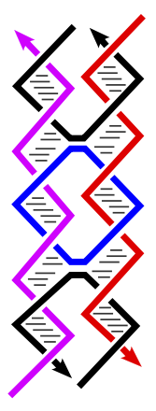
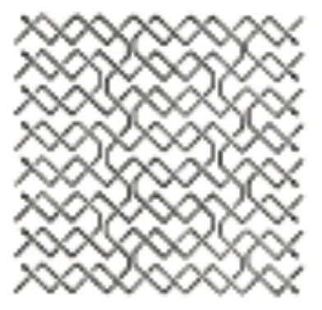
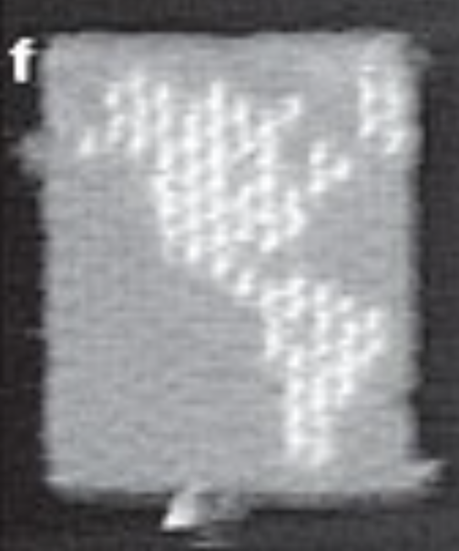
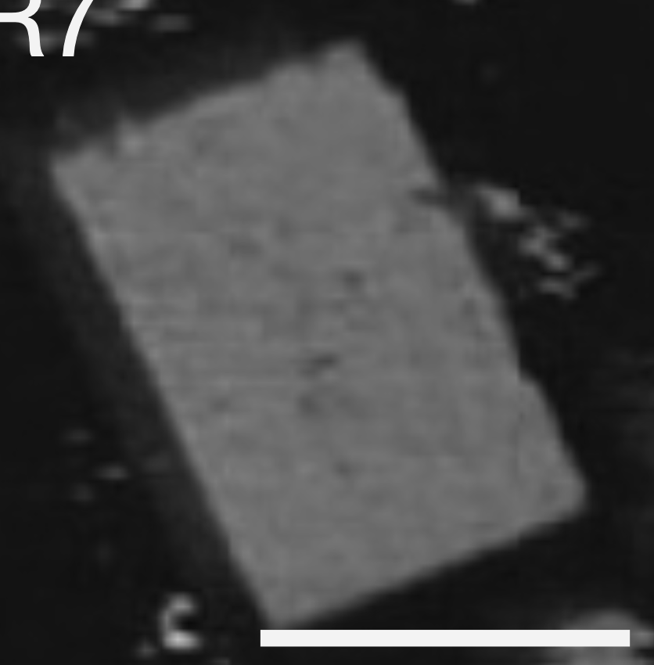
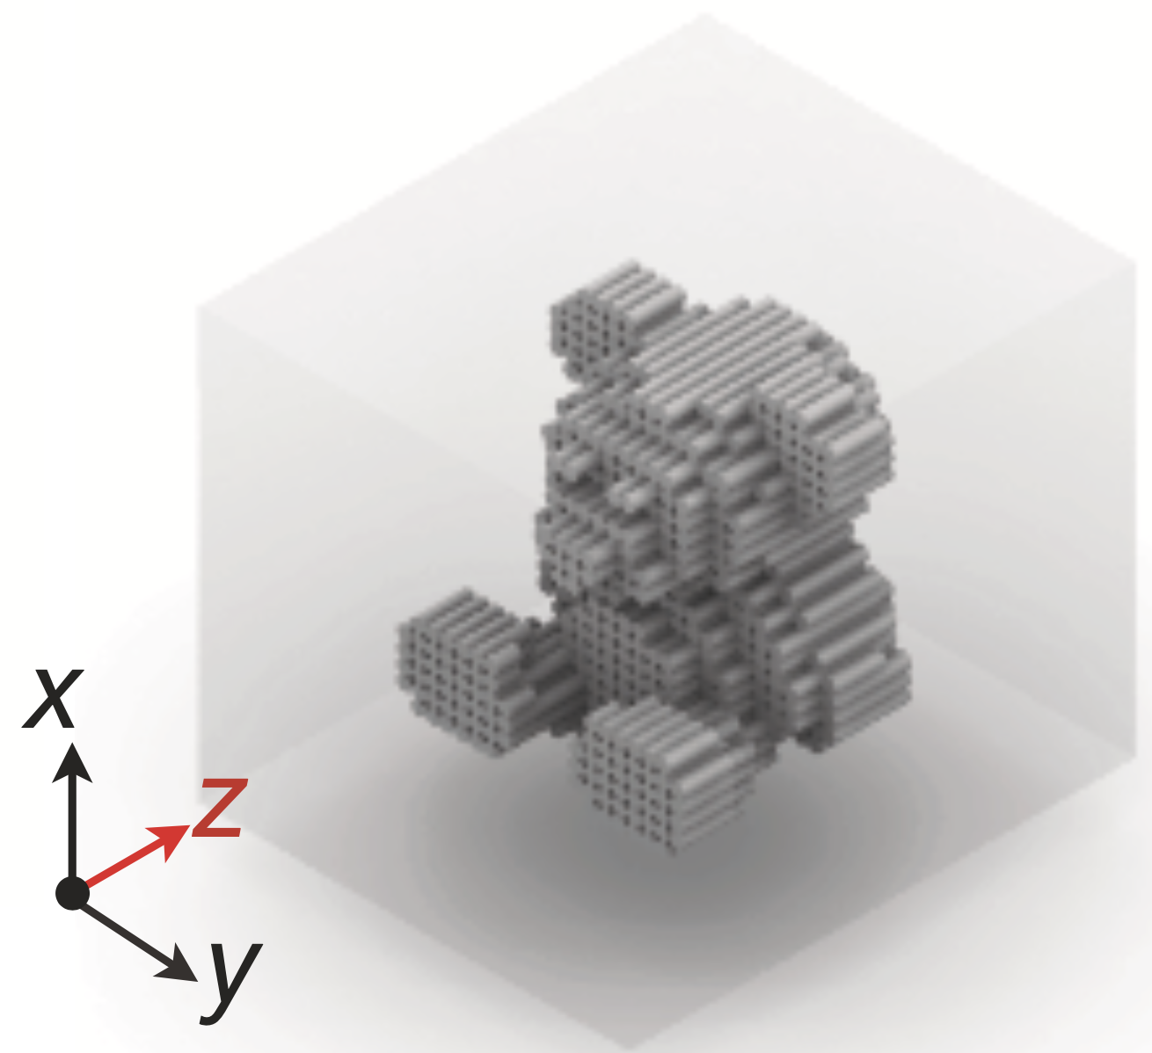
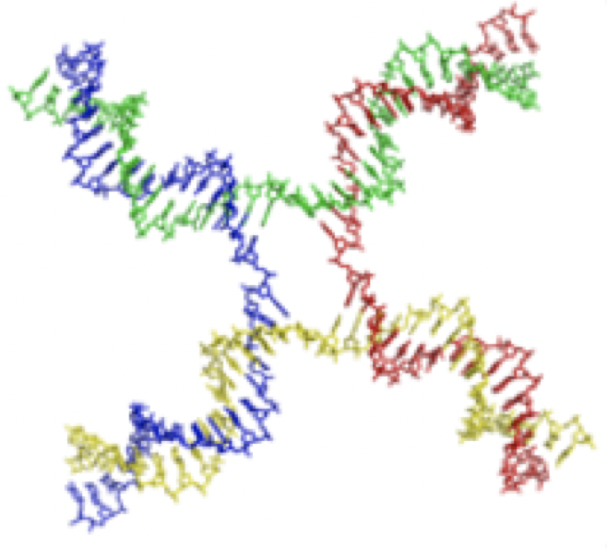
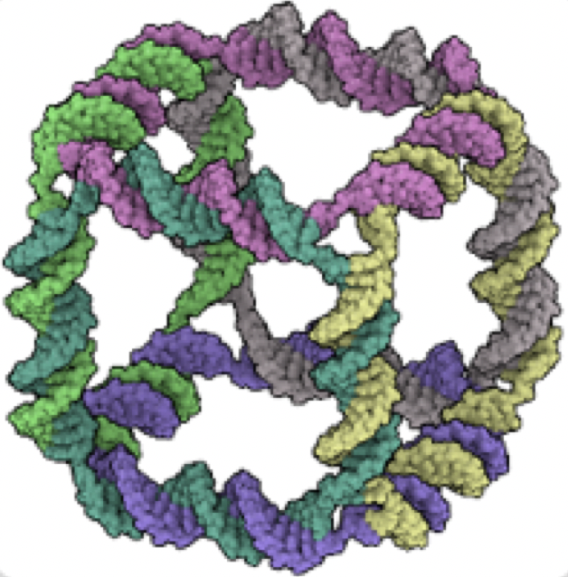




Progress in Structural DNA Nanotechnology
one-pot assembly
1983, 7 nm
1993, 14 nm
2005, 29 nm
2006, 120 nm
2012, 180 nm
2017, 100 nm
multi-stage
assembly of
structures
1991, 14 nm
2005, 250 nm
2006, 300 nm
2017, 1 um
2022, 2.5 um
Notes:
Let’s step back for a minute a look at how this field has developed over the years. Ned Seeman’s first structure in 1983 consisted of just four DNA strands and was about 7 nanometers in diameter, the size of a small protein. Researchers mastered the art of programming DNA self-assembly, using DNA origami as well as other design techniques, to design one-pot reactions that build structures now many thousands of times larger. If we look at structures built using multi-stage assembly techniques, the increase in size is even more dramatic.

Slide 14





Progress in Dynamic DNA Nanotechnology
computation
1994, HPP
~20 strands
Adleman
2000, CNF-SAT
~60 strands
Sakamoto et al
2003, tic-tac-toe
~30 strands
Stojanovic et al
2006, digital circuits
~40 strands
Seelig et al
2018, neural nets
~500 strands
Cherry & Qian
Notes:
Computing has advanced much more slowly. Partly this is due to a change in focus from Len Adleman’s early ideas for using the parallelism of chemistry to solve NP-complete problems — something that few have much interest in today — to the more exciting prospects of programmable embedded controllers that operate autonomously within molecular robotic systems, like the biological circuits that control cellular function. A recent direction in this work has been to replicate the logic of neural network computation to obtain robust pattern recognition and decision-making at the molecular level.

Slide 15



Applications of DNA Nanotechnology
lithographic-scale patterning of molecular devices
for optics & diagnostics & DNA sequencing
DNA molecular printer
Gopinath, …, Rothemund, Science, 2021
Benson et al, 2022
Start-ups and commercialization
About 20 companies employ DNA nanotechnology for products relating to biological imaging, diagnostic, therapeutics, proteomics, DNA sequencing
Notes:
Does the current state of DNA nanotechnology enable revolutionary commercial applications? I can’t say that it does, yet. What we mostly have are demonstrations of technological abilities that one could envision turning into commercial applications, with luck.
First one, out of Paul Rothemund’s group: fabrication that spans from the wafer scale down to the atomic scale by using E-beam lithography to pattern asymmetric sticky spots on silicon, then let DNA origami devices, loaded with whatever molecular components you need, self-assemble onto the wafer in the desired places and orientations. Here they demonstrated orientation-tuned single-molecule optical responses, but alternatively the DNA origami could be loaded with molecules that detect specific targets for diagnostics, or that perform biophysical measurements on molecules that they encounter. The 100 nm diameter space is enough room to build, at the molecular level, fairly complex molecular instrumentation and molecular machines.
Second one, out of Andrew Turberfield’s group: a multi-DNA-origami machine analogous to an XY pen plotter. It is controlled by adding DNA strands to release and then latch the sliding rails and pen at a new specific position, via toehold-mediated strand displacement reactions. Then the “pen” can be activated to carry out a reaction that, for example, deposits a specific molecule at its current position. It’s debatable whether this is the best way to draw patterns on a molecular canvas, but it is definitely demonstrating the technological ability to create and control a complex molecular machine.
I know of just a handful of companies that are employing DNA nanotechnology for commercial purposes, using DNA machines to augment biological imaging, improve molecular diagnostics and proteomics, or create molecular structures that aid the DNA sequencing pipeline. It’s a fairly limited activity outside of academia, then, and hard to predict when or whether it will really take off.

Slide 16

The Growth of Complexity in DNA Nanotech
structure (mass, multi-stage)
structure (design, one-pot)
structure (design, one-pot)
Notes:
Nonetheless, I’ll give a shot at some predictions. Here I’ve plotted the growth in complexity for various types of DNA systems from published work. The blue squares show the size of well-defined molecular structures synthesized using multi-stage assembly methods. Size is measured not by linear dimension, but by mass — i.e. how many nucleotides of DNA are there in the structure. It’s almost doubling every two years. Because in these structures it’s common for a subunit to be used multiple times in the final structure, such as the 12 blue subunits in the virus-sized DNA origami, the mass of the object is not a good measure of the complexity of the design. So for one-pot assembly, the green triangles, I choose to plot the “design complexity”: how many nucleotides of DNA sequence information had to be designed and synthesized, i.e. the length of the order form to the DNA synthesis company. This measure of how much information went into the design increases a little slower, and noisier, but still roughly exponentially, maybe doubling every 3 years. When it comes to the computational systems, the design complexity grows even slower. It seems that these dynamic systems are more challenging to design than the purely structural systems, which isn’t too surprising.
Exponential growth is certainly not to be taken for granted, but it seems to be how things have been playing out for the past 40 years. Will it keep going? We don’t know. But let’s imagine it. One reference point is the size of a typical bacterium, such as E. coli, which is about 1 cubic micron. A nucleotide is about 1 cubic nanometer, so to self-assemble a life-size molecular “statue” of a bacterium would require 10^9 nucleotides – which we can expect to be feasible within 15 years with multi-stage assembly. If we want a simple one-pot annealing procedure, then we may have to wait 30 years. If we want the molecular analog of a cell-scale cuckoo clock chock-full of moving parts and programmable autonomous logic circuitry (which we might call a “molecular robot”) then we may have to wait 50 years.
Or maybe these curves will flatten out, and we won’t be able to create molecular systems beyond a certain complexity level. What could be the bottlenecks that we might encounter? Unlike VLSI, our feature size isn’t changing — a nucleotide is 20 atoms, was always 20 atoms and will always be 20 atoms. So there’s no bottleneck to improving feature size, because we’re not doing that. What’s changing is how large of a system we can get to work well enough to write a convincing academic paper. Complexity. It seems that if we can get a system of N components to work, then with one more unit of time spent refining our understanding and technique, we’ll be able to get a system of 2N components to work. This trend would fail if the complexity gets out of hand and can no longer be controlled or understood.
Does the computer engineering community have lessons for us that we would be wise to heed, since computer engineering has been grappling with complexity for many years? Should we talk to today’s computer engineers, or yesterday’s? When was the complexity of microchips comparable to the complexity of today’s molecular systems? From this chart, we see that complexity has increased about 10^5-fold since the first demonstration of DNA nanotechnology 40 years ago; around 1982, CPU transistor counts increased about 10^5-fold since the first demonstration of a single transistor about 35 years earlier. So what was going on in the computer industry around 1982 that allowed design not to get bogged down in complexity?

Slide 17


The Mead-Conway VLSI Design Revolution
Slide on branch migration
DEVICES AN CIRCUITS
FABRICATION
DATA AND CONTROL FLOW
INTEGRATED SYSTEMS
THE OM2 DATA PATH
THE OM2 CONTROLLER CHIP
SYSTEM TIMING
CONCURRENT SYSTEMS
PHYSICS OF COMPUTATION
Notes:
This was about the time of the Mead-Conway VLSI chip design revolution – their book came out in 1980, walking students through transistor device physics and lithography all the way up to circuit and microprocessor architecture design. As I understand it, the accomplishment was to simplify and articulate the design principles such that the otherwise-bewildering complexity of building a computer could be entirely mastered by a single person — perhaps even a student. Abstracting away from the details of 1980’s computer engineering, I see three main design principles.

Slide 18



Analog Physics to Digital Abstraction
valid 1
V_{in}
V_{out}
valid 0
valid 0
valid 1
signal restoration cleans up noise, so abstraction can ignore it
Notes:
A digital abstraction provides robustness to details and imperfections of an underlying analog implementation. Imperfect input signals within a valid range for 0 or 1 are restored to more perfect signal values.

Slide 19

Design Rules for Fabrication
self-imposed limitations enable automated, systematic, reliable scaling
Notes:
Design rules help ensure that a layout can be reliably fabricated and will perform to spec on the first try, at the cost of prohibiting fancier and more clever layout optimizations that might perform better but may require more fine tuning and debugging.

Slide 20

The Abstraction Hierarchy
hierarchical compilation from high-level to low-level manages design complexity
Notes:
Going from silicon device physics to transistors to Boolean logic gates are just the first three layers of an abstraction hierarchy, where each higher layer is constructed to abstract away details from the layer below, so it’s easier to think about. Most importantly, a design conceived at a high level can be translated, via tools such as compilers, down to an implementation at the lower level.

Slide 21

The Tall Thin Computer Engineer
…with their head in the clouds and their feet on the ground.
Notes:
In the early 1980s, a single person could get a pretty good handle on the whole stack, from top to bottom. Carver Mead called that person the “Tall Thin Computer Engineer” and emphasized how they could often design better systems by understanding how the layers interact with each other, and more importantly, when architecting a new computer, they could help redefine how the layers of abstraction are constructed such that the whole stack works better together.

Slide 22
The Tall Thin Molecular Programmer
Higher-level languages
Molecular network interactions
Molecular design abstraction
DNA sequences
DNA molecules
Notes:
The notions of digital abstraction, design rules, and abstraction hierarchy may be passe and obvious now, but it’s worth reminding ourselves of how important they are when developing a new technology that similarly has design complexity as a major bottleneck. Can these concepts be applied in a context that is seemingly so different from VLSI? Is there a place for a tall thin molecular programmer?

Slide 23


Analog Physics to Digital Abstraction
Seelig, Soloveichik,
Zhang, Winfree
Science, 2006
Qian, Winfree, Science, 2011
signal restoration cleans up noise, so abstraction can ignore it
Notes:
Initial steps in these directions have been taken in molecular programming with DNA nanotechnology. When computational signals are represented by the analog concentrations of specific DNA molecules, a chemical circuit whose input/output function has a sharp threshold can serve as the basis for signal restoration and a digital abstraction.

Slide 24



Analog Physics to Digital Abstraction
Associative memory, attractor networks
DNA neural networks
Qian, Winfree, Bruck
Nature, 2011
Hopfield, Complexity in Information Theory, 1988
signal restoration cleans up noise, so abstraction can ignore it
Notes:
Similar benefits of noise reduction and robustness might be obtained via non-binary digital abstractions as well, such as discrete signals being represented by the attractor basins of a recurrent neural network. Perhaps surprisingly, neural network computational architectures sometimes map surprisingly well onto chemical circuits.

Slide 25







Design Rules for Fabrication
DNA origami – Rothemund 2006
Be a DNA purist!
Visual DSD – Lakin et al 2012
Algorithmic SST tiles – Woods, Doty, et al 2019
self-imposed limitations enable automated, systematic, reliable scaling
Notes:
There is a sense in which the very choice of using DNA for molecular engineering — rather than incorporating the full spectrum of available chemistries — is a design rule: it is already far more predictable and reliable than almost any other general class of programmable molecules, but comes at the cost of foregoing the capabilities of richer (but less predictable) chemistries. But beyond that, each approach to system design in DNA nanotechnology comes with its own design rules — though often not yet stated as clearly as they could be. DNA origami, in its original form, relies on parallel helices and half-turn segments, allowing design to be systematic. DNA strand displacement circuits can be designed with standard domain lengths and standard reaction mechanisms. DNA tile self-assembly can use standard shapes and sizes to ensure regular and predictable assembly pathways.

Slide 26


The Abstraction Hierarchy
Higher-level languages
Abstract molecular systems
Domain-level specification
DNA sequences
DNA molecules
Srinivas, Parkin, Seelig, Winfree, Soloveichik, Science, 2017
Woods, Doty, et al, Nature, 2019
hierarchical compilation from high-level to low-level manages design complexity
Notes:
It is possible to build an abstraction stack for molecular system design. This has been demonstrated in a few cases, for systems involving so far only at most a few hundred molecules, and with an abstraction stack that only goes up a few layers. Shown is a DNA strand displacement oscillator and DNA tile self-assembly implementation of iterated Boolean logic circuits.

Slide 27
The Tall Thin Molecular Programmer
Higher-level languages
Molecular network interactions
Molecular design abstraction
DNA sequences
DNA molecules
Notes:
I titled my talk “the tall thin molecular programmer” because, first, I wanted to recognize the value of molecular engineers learning from the experiences of computer engineers, and second, I wanted to call attention to the need for people who see the whole stack, because they are the ones best positioned to refine or change the choice of abstractions to make this kind of molecular engineering more reliably programmable, and thus to enable the continued growth of design complexity that will be necessary for more powerful applications.

Slide 28
Thank you for listening!
Notes:
Thank you for listening. And I want to thank all computer engineers for pioneering the path and principles for creating complex and beautiful information technologies.

